Slide 1
Passing Cars
Count the number of passing cars on the road.
Problem on Prefix Sums

Slide 2
Problem
A non-empty array A consisting of N integers is given. The consecutive elements of array A represent consecutive cars on a road.
Array A contains only 0s and/or 1s:
0 represents a car traveling east,
1 represents a car traveling west.
The goal is to count passing cars. We say that a pair of cars (P, Q), where 0 ≤ P < Q < N, is passing when P is traveling to the east and Q is traveling to the west.
Write a function:
def solution(A)
that, given a non-empty array A of N integers, returns the number of pairs of passing cars.
The function should return −1 if the number of pairs of passing cars exceeds 1,000,000,000.
Write an efficient algorithm for the following assumptions:
N is an integer within the range [1..100,000];
each element of array A is an integer that can have one of the following values: 0, 1.

Slide 3
Example
For example, consider array A such that:
A[0] = 0
A[1] = 1
A[2] = 0
A[3] = 1
A[4] = 1
We have five pairs of passing cars: (0, 1), (0, 3), (0, 4), (2, 3), (2, 4).
For example, given:
the function should return 5, as explained above.

Slide 4
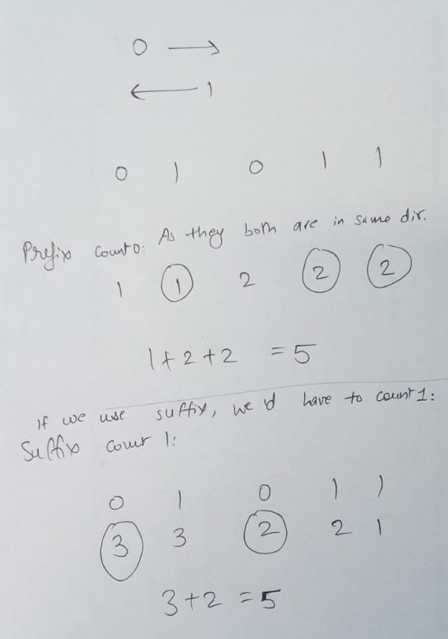
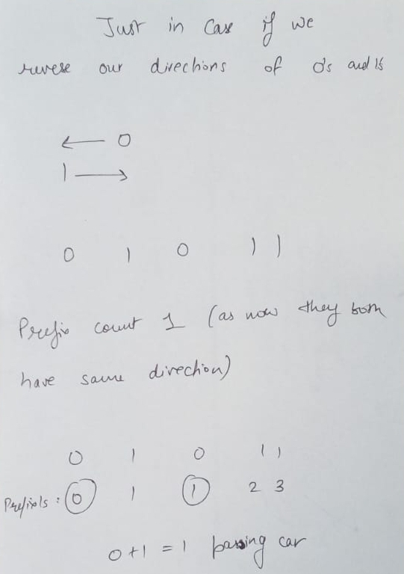
Hint

Slide 5
Code (I)
def solution(A):
# In the question, it is given that 0 are travelling east. We assume it to be the direction of prefix sums.
# So if we implement using prefix counts, we would have to count zeroes.
# '1' is going to the west, that is having the direction of suffix sums.
prefix_counts = [0] * (len(A) + 1)
for i in range(len(A)):
if A[i] == 0:
prefix_counts[i+1] = prefix_counts[i] + 1
else:
prefix_counts[i+1] = prefix_counts[i] + 0
passing_cars = 0
for i in range(len(A)):
if A[i] == 1:
passing_cars += prefix_counts[i+1]
if passing_cars > 1000000000:
passing_cars = -1
return passing_cars

Slide 6
Code (II): Now Using Suffix Sums
def solution(A):
# In the question, it is given that 0 are traveling east. We assume it to be the direction of prefix sums.
# '1' is going to the west, that is having the direction of suffix sums.
# So if we implement using suffix counts, we would have to count ones.
suffix_counts = [0] * (len(A) + 1)
for i in range(len(A) - 1, -1, -1):
if A[i] == 1:
suffix_counts[i] = suffix_counts[i+1] + 1
else:
suffix_counts[i] = suffix_counts[i+1] + 0
passing_cars = 0
for i in range(len(A)):
if A[i] == 0:
passing_cars += suffix_counts[i]
if passing_cars > 1000000000:
passing_cars = -1
return passing_cars

Slide 7
Time Complexity
Detected time complexity:
O(N)

Slide 8
Tests
Correctness tests
single element
double
two elements
simple
simple test
small_random
random, length = 100
small_random2
random, length = 1000
Performance tests
medium_random
random, length = ~10,000
large_random
random, length = ~100,000
large_big_answer
0..01..1, length = ~100,000
large_alternate
0101..01, length = ~100,000
large_extreme
large test with all 1s/0s, length = ~100,000

